Slide 1
Software Quality Assurance and Testing Lecture - 01
Abdus Satter
Lecturer
Institute of information technology
University of dhaka

Slide 2
Introduction to software testing

Slide 3
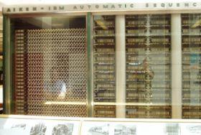

What is a computer bug?
In 1947 Harvard University was operating a room-sized computer called the Mark II.
mechanical relays
glowing vacuum tubes
technicians program the computer by reconfiguring it
Technicians had to change the occasional vacuum tube.
A moth flew into the computer and was zapped by the high voltage when it landed on a relay.
Hence, the first computer bug!

Slide 4
Bugs a.k.a. …
Defect
Fault
Problem
Error
Incident
Anomaly
Variance
Failure
Inconsistency
Product Anomaly
Product Incidence
Feature :-)

Slide 5
Defective Software
We develop programs that contain defects
How many? What kind?
Hard to predict the future, however… it is highly likely, that the software we (including you!) will develop in the future will not be significantly better.

Slide 6
Sources of Problems
Requirements Definition: Erroneous, incomplete, inconsistent requirements.
Design: Fundamental design flaws in the software.
Implementation: Mistakes in chip fabrication, wiring, programming faults, malicious code.
Support Systems: Poor programming languages, faulty compilers and debuggers, misleading development tools.

Slide 7
Sources of Problems (Cont’d)
Inadequate Testing of Software: Incomplete testing, poor verification, mistakes in debugging.
Evolution: Sloppy redevelopment or maintenance, introduction of new flaws in attempts to fix old flaws, incremental escalation to inordinate complexity.

Slide 8
Adverse Effects of Faulty Software
Communications: Loss or corruption of communication media, non delivery of data.
Space Applications: Lost lives, launch delays.
Defense and Warfare: Misidentification of friend or foe.

Slide 9
Adverse Effects of Faulty Software (Cont’d)
Transportation: Deaths, delays, sudden acceleration, inability to brake.
Safety-critical Applications: Death, injuries.
Electric Power: Death, injuries, power outages, long-term health hazards (radiation).

Slide 10
Adverse Effects of Faulty Software (Cont’d)
Money Management: Fraud, violation of privacy, shutdown of stock exchanges and banks, negative interest rates.
Control of Elections: Wrong results (intentional or non-intentional).
Control of Jails: Technology-aided escape attempts and successes, accidental release of inmates, failures in software controlled locks.
Law Enforcement: False arrests and imprisonments.

Slide 11
Northeast Blackout (August 2003)
It was the worst power system failure in North American history. The failure involved loss of electrical power to 50 million customers, forced shutdown of 100 power plants and economic losses estimated at $6 billion. The bug was reportedly in one utility company’s vendor-supplied power monitoring and management system. The failures occurred when multiple systems trying to access the same information at once got the equivalent of busy signals. The software should have given one system precedent. The error was found and corrected after examining millions of lines of code.

Slide 12
Definition of Software Testing
Software testing is the process of executing a software system to determine whether it matches its specification and executes in its intended environment.

Slide 13
Software Testing
Testing is the process of executing a program with the intent of finding errors. - Myers [2]
A successful test is one that uncovers an as-yet-undiscovered error. - Myers [2]
Testing can show the presence of bugs but never their absence. - W. Dijkstra [125]

Slide 14
SOFTWARE TESTING— MYTHS AND FACTS
Myth-1: Testing is a single phase in SDLC .
Myth-2: Testing is easy.
Myth-3: Software development is worth more than testing.
Myth-4: Complete testing is possible.
Myth-5: Testing starts after program development.
Myth-6: The purpose of testing is to check the functionality of the software
Myth-7: Anyone can be a tester.

Slide 15
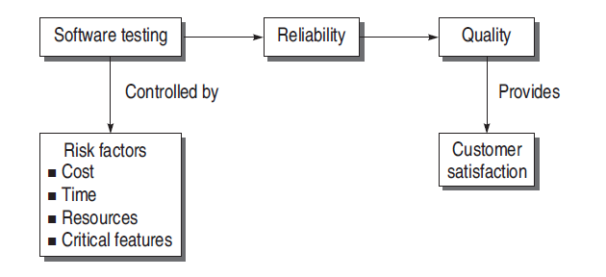
GOALS OF SOFTWARE TESTING
Short-term or immediate goals
Bug discovery
Bug prevention
Long-term goals
Quality
Customer satisfaction
Risk management
Post-implementation Goals
Reduced maintenance cost
Improved testing process

Slide 16
PSYCHOLOGY FOR SOFTWARE TESTING
Testing is the process of demonstrating that there are no errors.
Testing is the process of executing a program with the intent of finding errors.

Slide 17
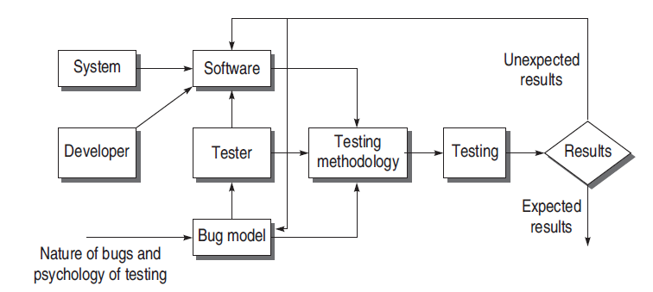
MODEL FOR SOFTWARE TESTING

Slide 18
Why Can’t Every Bug be Found?
Exhaustive software testing is not feasible
Too many possible paths.
Too many possible inputs.
Too many possible user environments.

Slide 19
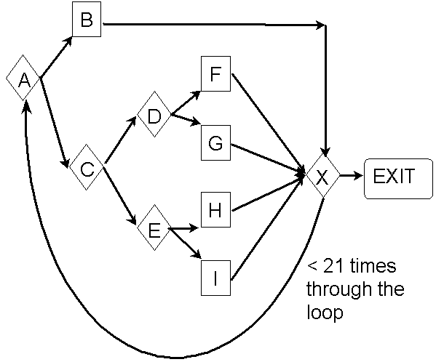
Too Many Possible Paths

Slide 20
Too Many Possible Inputs
Programs take input in a variety of ways: mouse, keyboard, and other devices.
Must test Valid and Invalid inputs.
Most importantly, there are an infinite amount of sequences of inputs to be tested.

Slide 21

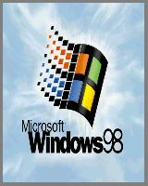


Too Many Possible User Environments
Difficult to replicate the user’s combination of hardware, peripherals, OS, and applications.
Impossible to replicate a thousand-node network to test networking software.

Slide 22
Thank You
End of Chapter

